Slide 1

2D Closest pair problem (Divide&Conquer alghorithm)

Slide 2
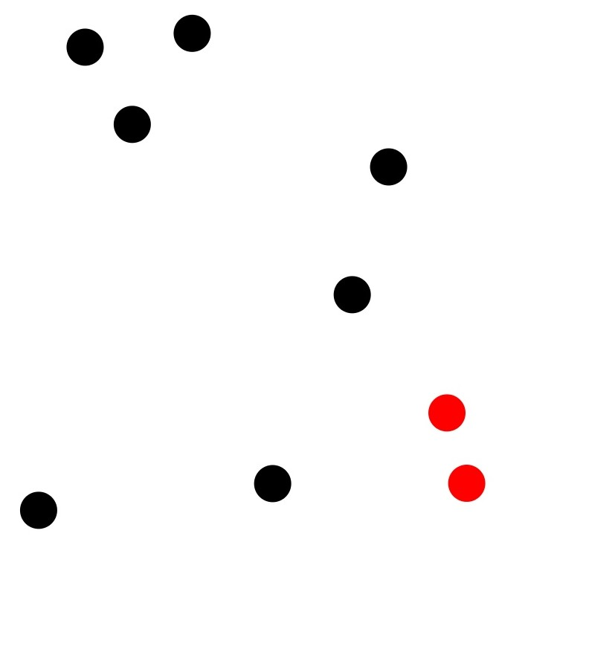
AGENDA
Description of The Problem
Divide and Conquer Algorithm
The Designed Algorithm
Implementation Details
Analysis of the Algorithms
Demo

Slide 3

2D Closest Pair Problem Description

Slide 4
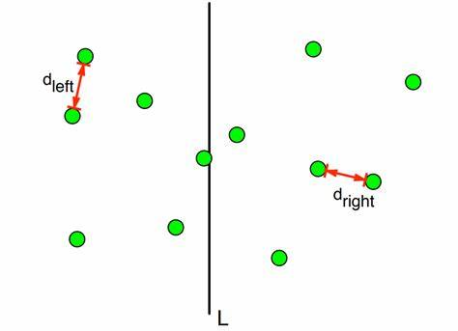
2D Closest Pair Problem
The 2D Closest Pair problem involves finding the two points in a set of points in a 2-dimensional plane that are closest to each other.
This problem is fundamental in computational geometry and has applications in fields such as computer graphics, geographic information systems, and clustering analysis.

Slide 5
Divide and Conquer Algorithm

Slide 6
Divide and Conquer Algorithm
The Divide and Conquer algorithm works by recursively dividing the set of points into smaller subsets, solving the problem for these subsets, and then combining the results to find the closest pair. The key steps are:
Divide: Split the set of points into two halves.
Conquer: Recursively find the closest pair in each half.
Combine: Merge the results from the two halves and find the closest pair that straddles the dividing line.

Slide 7
The Designed Algorithm

Slide 8
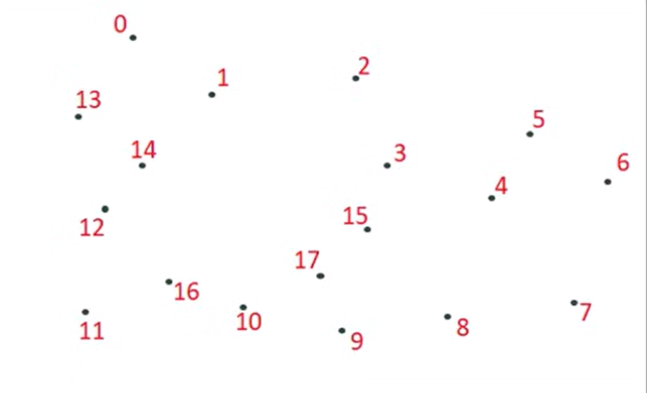
The Designed Algorithm
Input: An array of n points P [0, 1, 2, 3, 4, 5, 6, 7, 8, 9, 10, 11, 12, 13, 14, 15, 16, 17]
Output: The smallest distance between two points in the given array.
As a pre-processing step, the input array is sorted according to x coordinates:
Find the middle point in the sorted array, we can take P[n/2] as middle point.
P[n/2]=p[9]=17

Slide 9
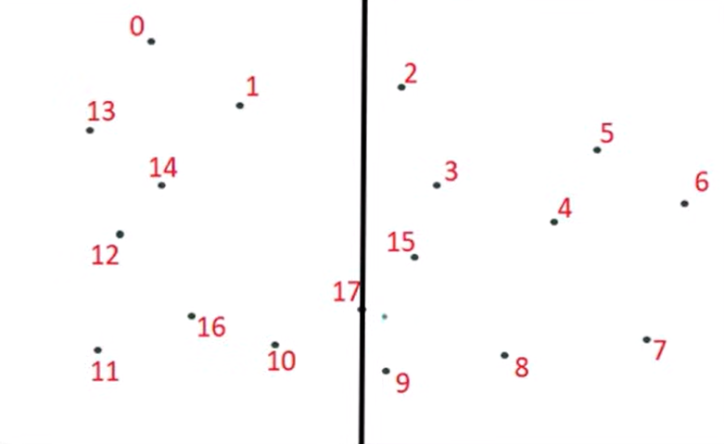
The Designed Algorithm
Divide the given array in two halves. The first subarray contains points from P[0] to P[n/2]. The second subarray contains points from P[n/2+1] to P[n-1].
PL=[0, 1, 2, 3, 4, 5, 6, 7, 8]
PR=[9, 10, 11, 12, 13, 14, 15, 16, 17]

Slide 10
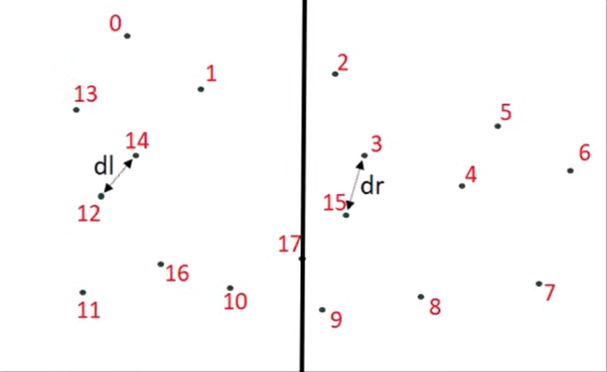
The Designed Algorithm
Recursively find the smallest distances in both subarrays. Let the distances be dl and dr. Find the minimum of dl and dr. Let the minimum be d..
D=min(dl,dr)

Slide 11
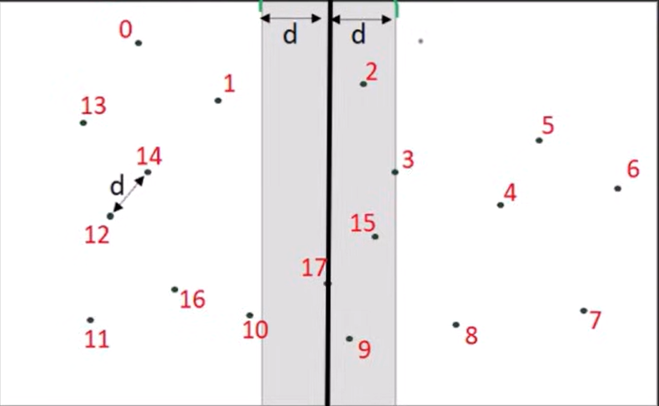
The Designed Algorithm
From the above 3 steps, we have an upper bound d of minimum distance. Now we need to consider the pairs such that one point in pair is from the left half and the other is from the right half. Consider the vertical line passing through P[n/2] and find all points whose x coordinate is closer than d to the middle vertical line. Build an array strip[] of all such points.
Strip[ ]={17,9,2,15,3}

Slide 12
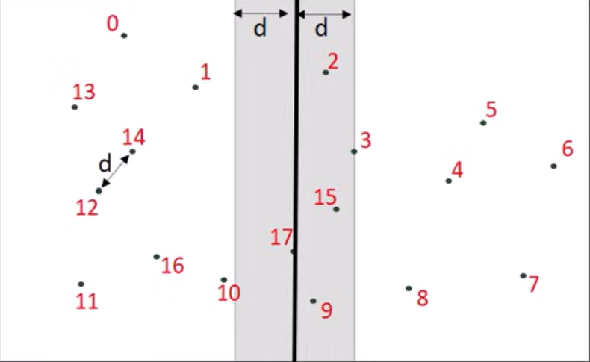
The Designed Algorithm
Sort the array strip[] according to y coordinates. This step is O(nLogn). It can be optimized to O(n) by recursively sorting and merging.
Strip[ ]={2,3,9,15, 17}

Slide 13
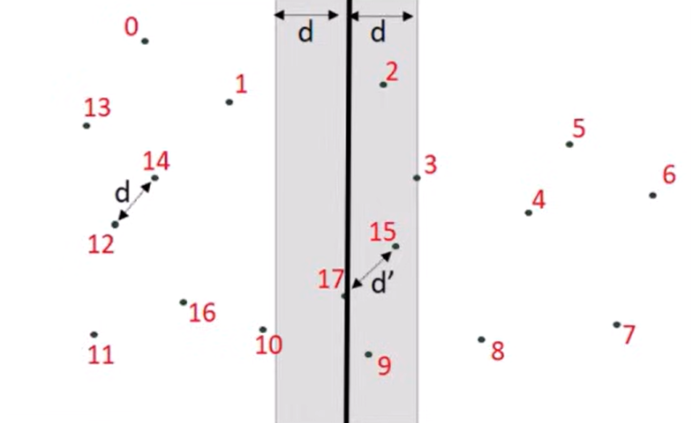
The Designed Algorithm
Find the smallest distance in strip[]. This is tricky. From the first look, it seems to be a O(n^2) step, but it is actually O(n). It can be proved geometrically that for every point in the strip, we only need to check at most 7 points after it (note that strip is sorted according to Y coordinate).

Slide 14
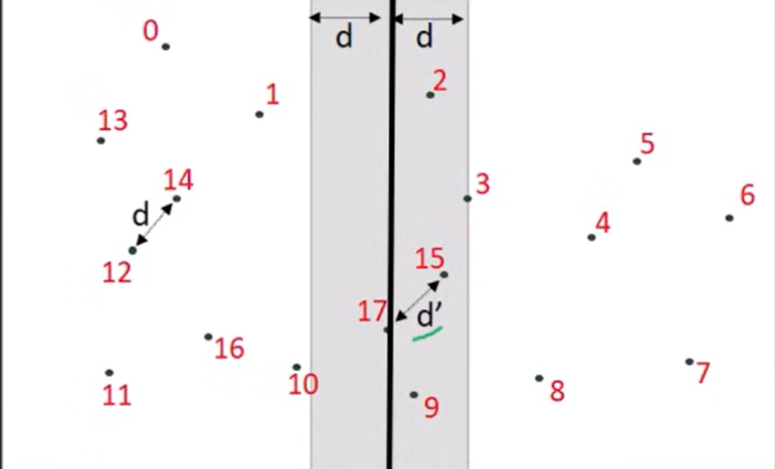
The Designed Algorithm
Finally return the minimum of d and distance calculated in the above step (step 6)

Slide 15
Implementation Details

Slide 16
Implementation Details
Distance Calculation Function: The distance function, responsible for computing the Euclidean distance between two points, serves as a fundamental component of the algorithm. It facilitates distance comparisons and optimizations throughout the implementation.
Brute Force Method: Despite its inefficiency for large datasets, the brute_force function ensures correctness by exhaustively checking all pairs of points to find the closest pair. While not suitable for large inputs, it provides a reliable fallback for small subsets of points.
Strip Closest Function: The strip_closest function optimizes the search for the closest pair within a specified vertical strip. By sorting points by their y-coordinates and employing a nested loop, it efficiently identifies potential closest pairs within the strip, contributing to overall algorithm performance.
Recursive Closest Pair Function: The closest_pair_rec function embodies the core divide-and-conquer strategy of the algorithm. By recursively dividing the point set into smaller subsets, it leverages the efficiencies of both the brute force and strip closest methods to identify the closest pair efficiently.
Main Function: The closest_pair function orchestrates the execution of the algorithm by sorting the input points and invoking the recursive function closest_pair_rec. It encapsulates the entire process of finding the closest pair and returns the result along with their distance, providing a seamless interface for users.

Slide 17
Analysis of the Algorithms

Slide 18
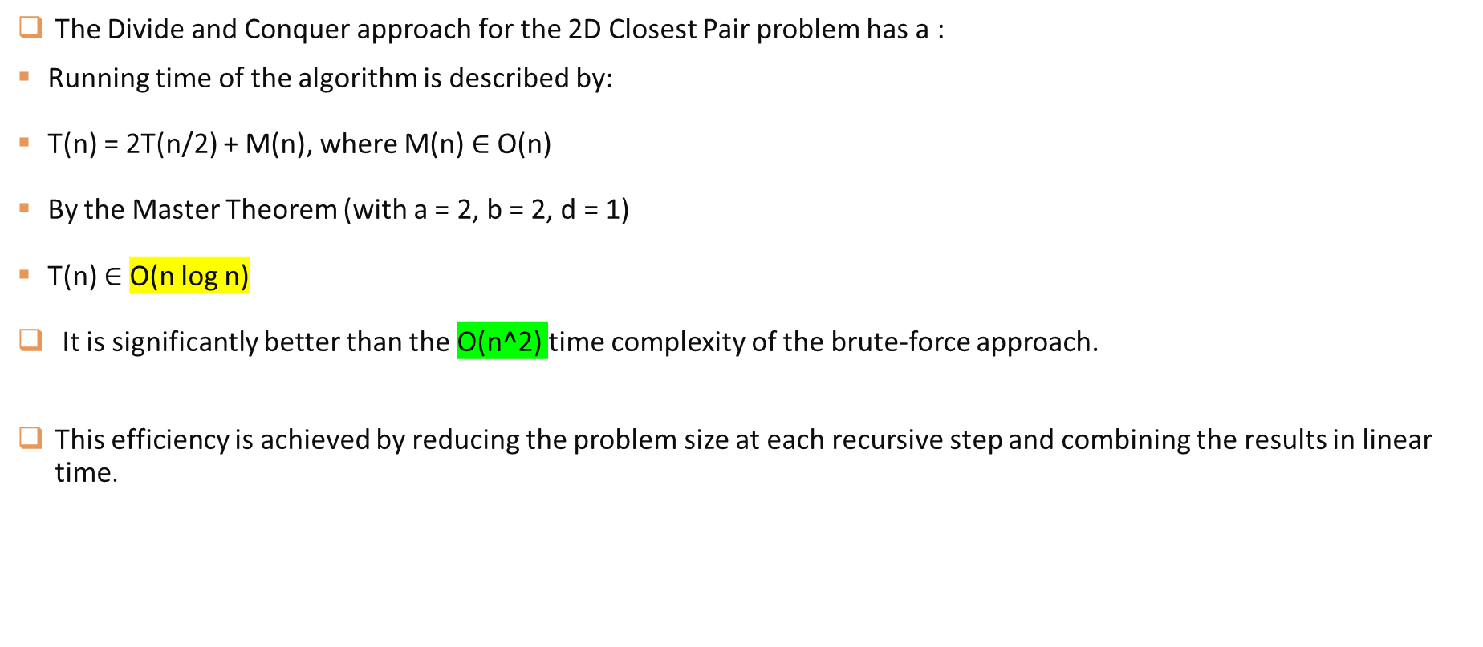
Analysis of the Algorithms
The Divide and Conquer approach for the 2D Closest Pair problem has a :
Running time of the algorithm is described by:
T(n) = 2T(n/2) + M(n), where M(n) $∈$ O(n)
By the Master Theorem (with a = 2, b = 2, d = 1)
T(n) $∈$ O(n log n)
It is significantly better than the O(n^2) time complexity of the brute-force approach.
This efficiency is achieved by reducing the problem size at each recursive step and combining the results in linear time.

Slide 19
Demo

Slide 20
Demo
https://youtu.be/wn5ROfD5urM

Slide 21

THANK YOU
Amr Emad Ghonaemy
224163

